Slide 1
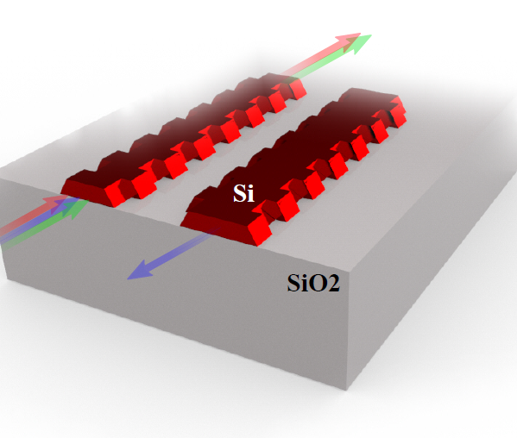
Understanding Contra-directional couplers photonic band diagrams
Mustafa Hammood

Slide 2
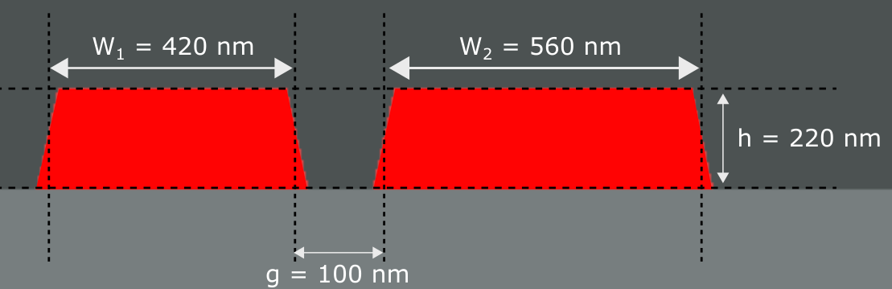
Waveguides Geometry

Slide 3
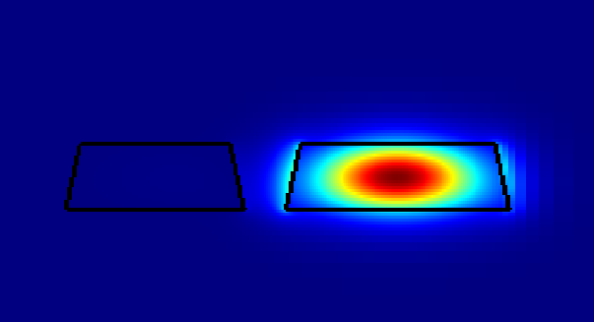
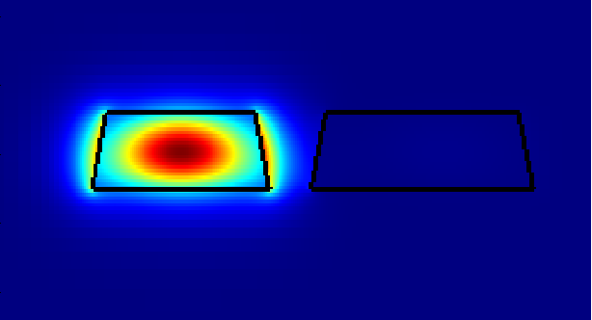
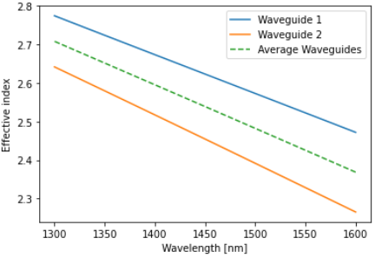
Modes in the system near λ=1550 nm

Slide 4
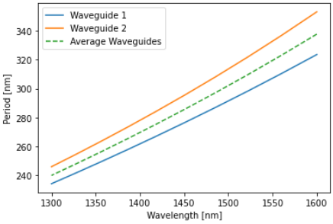
Modes in the system near λ=1550 nm

Slide 5







Modes in the system near λ=1550 nm
$λ_{wg2}=$1516.8 nm
$λ_{wg2}=$1511.4 nm
$λ_{CDC}=$1551.9 nm
$$Λ=\frac{λ}{2 n(λ)}$$
$λ_{CDC}=$1545.6 nm
$λ_{wg1}=$1589.2 nm
$λ_{wg1}=$1582.9 nm

Slide 6
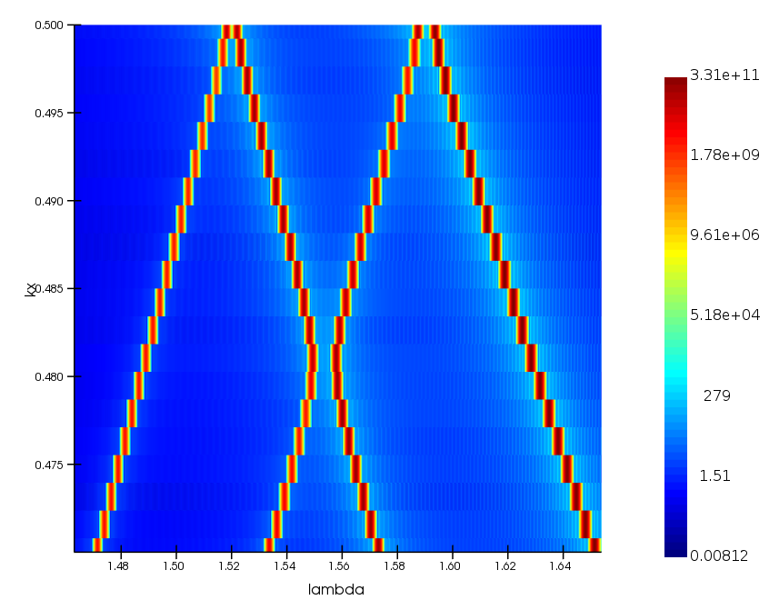

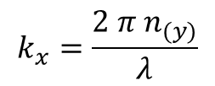
Photonic Band Structure near λ=1550 nm
$$k_{x0}=\frac{π}{Λ}=0.5$$
$$k_{x}=\frac{2 π{ n}_{(y)}}{λ}$$

Slide 7
Photonic Band Structure near λ=1550 nm
TE0

Slide 8
Photonic Band Structure near λ=1550 nm
Waveguide’s
Self-reflection
TE0

Slide 9
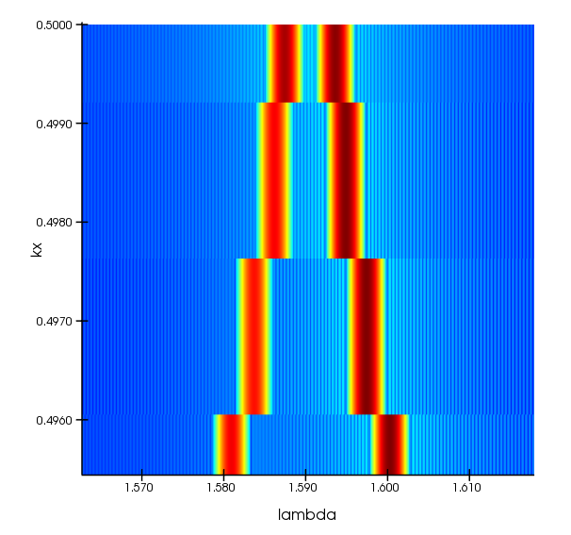
Photonic Band Structure near λ=1550 nm
Δλ = 6.2 nm
λ0 = 1590.5 nm
Waveguide’s
Self-reflection
TE0

Slide 10
Photonic Band Structure near λ=1550 nm
TE1

Slide 11
Photonic Band Structure near λ=1550 nm
Waveguide’s
Self-reflection
TE1

Slide 12
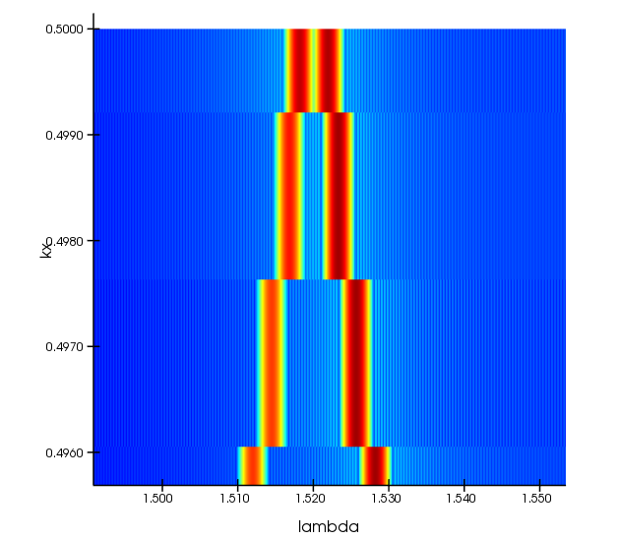
Photonic Band Structure near λ=1550 nm
Δλ = 3.75 nm
λ0 = 1520 nm
Waveguide’s
Self-reflection
TE1

Slide 13
Photonic Band Structure near λ=1550 nm

Slide 14
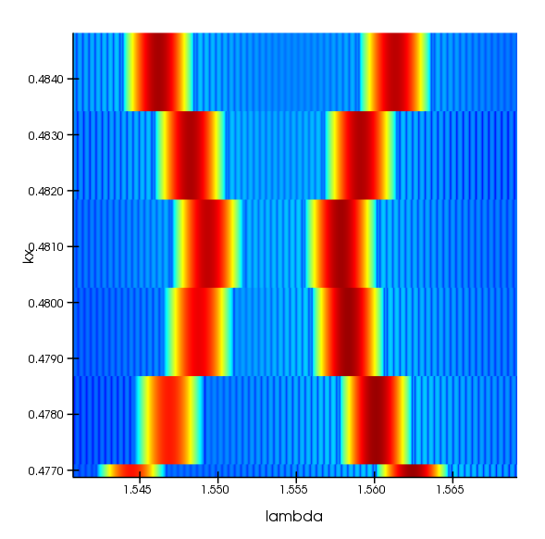
Photonic Band Structure near λ=1550 nm
Δλ = 8.4 nm
λ0 = 1553.5 nm
Contra-Directional
Coupling

Slide 15
What’s happening outside λ=1550 nm?

Slide 16
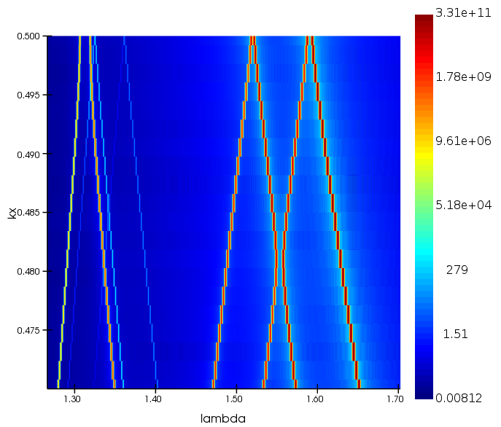
Photonic Band Structure - broadband

Slide 17
Photonic Band Structure - broadband
What’s happening in the
O and E wavelength bands?

Slide 18
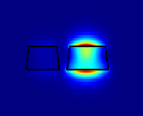
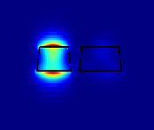
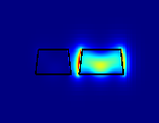
Modes in the system near λ=1310 nm
TM0
TM1
Slot mode

Slide 19
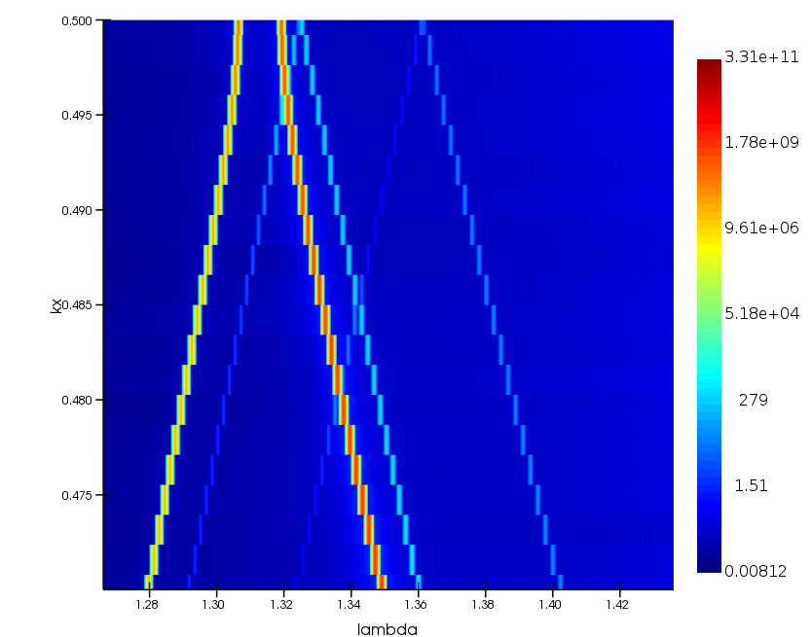
Photonic Band Structure near λ=1310 nm

Slide 20
Photonic Band Structure near λ=1310 nm
TM0

Slide 21
Photonic Band Structure near λ=1310 nm
TM1

Slide 22
Photonic Band Structure near λ=1310 nm
Slot

